Slide 1
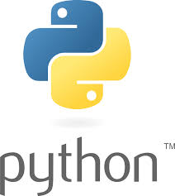
Python Programming
Theeba. K

Slide 2
Python
Session | Module
Day 1 | Lesson 1 : Introduction to Python Lesson 2 : Python types & variables Lesson 3 : operators Lesson 4 : conditional & Loop statements
Day 2 | Lesson 5 : List ,tuple Lesson 6 : Dictionary & set operations Lesson 7 : File Handling

Slide 3
Python
Session | Module
Day 3 | Lesson 8 : Function call and arguments, scopes Lesson 9 : About python module and pip/pip3
Day 4 | Lesson 10 : Exception Handling Lesson 11 : List Comprehension and lambda Lesson 12 : map, filter, reduce
Day 5 | Lesson 13: Object Oriented Programming Concepts Lesson 14: Python objects /methods Lesson 15: Case studies

Slide 4
Lesson - 1

Slide 5

Introduction about Python
Python is an interpreted, high-level, general-purpose programming language.
Created by Guido van Rossum and first released in 1991.

Slide 6
Introduction about Python
Python is an easy to learn, powerful programming language.
It has efficient high-level data structures and a simple but effective approach to object-oriented programming.
The Python interpreter and the extensive standard library are freely available in source or binary form for all major platforms from the Python Web site, https://www.python.org/, and may be freely distributed.

Slide 7
Introduction about Python
The Python interpreter is easily extended with new functions and data types implemented in C or C++
(or other languages callable from C).
Python is also suitable as an extension language for customizable applications.

Slide 8
Why python ?
Easy to Learn and Use
Interpreted Language
Cross-platform Language
Free and Open Source
Object-Oriented Language
Large Standard Library
GUI Programming Support
Dynamically typed language

Slide 9
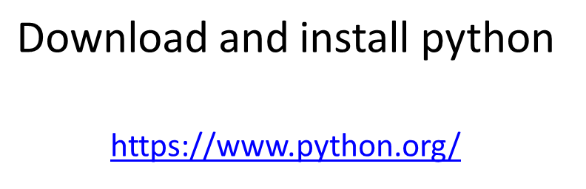
How to install python ?

Slide 10
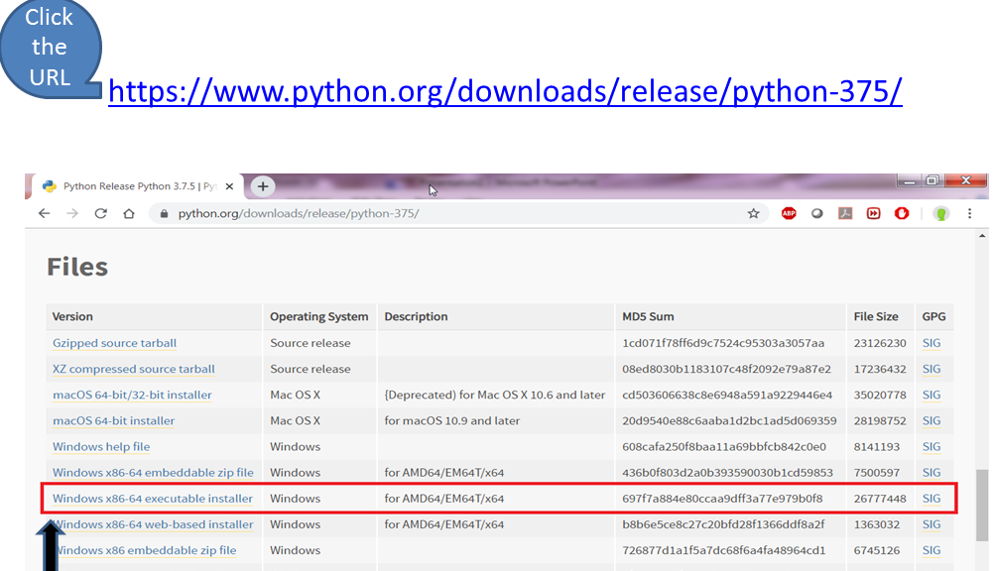


Slide 11

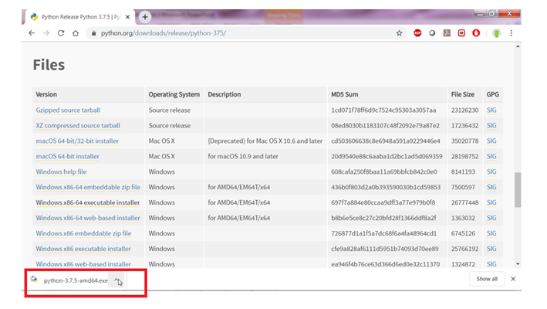

Slide 12
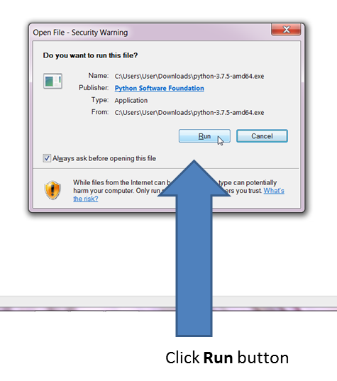

Slide 13
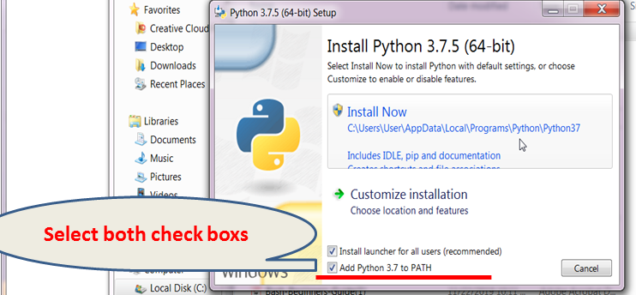

Slide 14

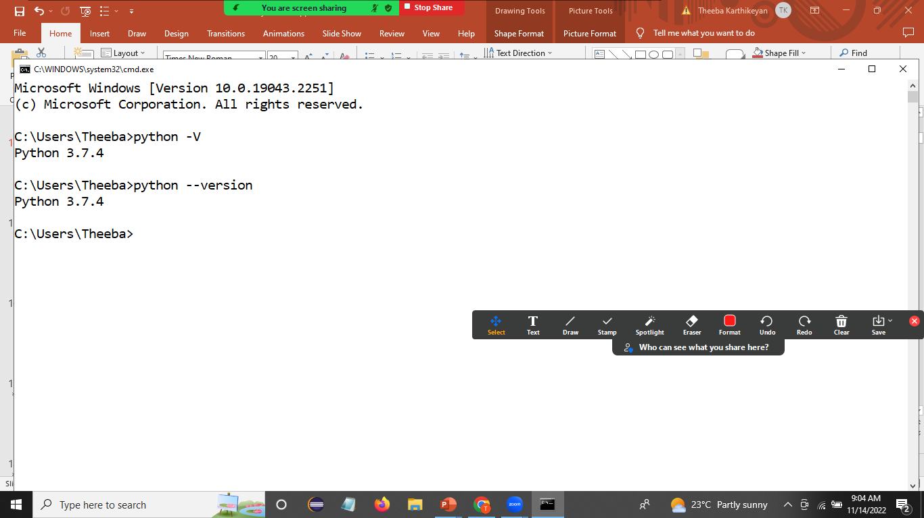
Test your python version
After completion of successful installation, open a new command line shell and type the above commands.
Note: python –V ( V uppercase char)

Slide 15
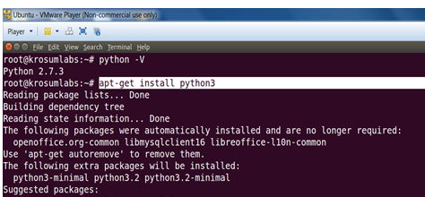
Linux
root@hostname~]# yum install python3 {Enter}
root@hostname~]# apt-get install python3 {Enter}

Slide 16
Test your python – in Linux
root@hostname~]# python –V
python 2.7.5
root@hostname~]# python3 –V
python 3.7.5
root@hostname~]# python3 - -version
python 3.7.5
Note: python3 –V ( V uppercase char)

Slide 17
How to run python program?
1. Python subshell
2. Editor(notepad,notepad++) or IDEs (Eclipse,pycharm,padre etc.,)

Slide 18

Understanding the python program execution.
C:\> python filename.py
root@hostname~]# python filename.py
root@hostname~]# python3 filename.py

Slide 19
Python comments
Single line comment #
Multiline comment
‘’’
Multiline
comments
‘’’

Slide 20

print(); type();dir()
print() – display message to monitor
print(named_variable)
print(“user defined string”)
Ex: print(“Hello”)
print(10)
type() – To determine python type/class
type(named_variable) (or) type(value)
Ex: type(10) -> <class ‘int’>
dir() - which returns list of the attributes and methods of any object (say functions , modules, strings, lists, dictionaries etc.)
dir(“named_variable”) (or) dir(value)
Ex: dir(10)

Slide 21
Quiz
Q1. How to check python version?
A. python –v
B. python - -version
C. python –V
D. option B and C both
E. Option B only
Notes:
ANS : D

Slide 22
Quiz
Q2. Is python, a case sensitive language?
Yes
No
Notes:
ANS : A

Slide 23
Quiz
Q3. How to check the type of a value in python?
print()
type()
dir()
Notes:
ANS : B

Slide 24
Lesson - 2

Slide 25
Data types in Python
Numbers (int,float,complex)
String (str)
Bytes (bytes)
Boolean( bool )
NoneType(None)
Python containers (collections)
List (list)
Tuple (tuple)
Dictionary (dict)
Set (set)

Slide 26
Variable
variable – namespace – it’s holding a value
Syntax:-
variablename = value
var=10
name=‘root’
cost=14.53
status=True
Here var, name , cost and status are variables

Slide 27
Activity
Q1. what are declarations are invalid declarations
$var=10
5var=10
VAR=10
Var=10
var=10
F_name=“”
s name=“”

Slide 28
Activity
Write a python program
Step 1: open an IDLE or any std editor
Step 2: create a file p1.py
Step 3: Within p1.py, declare variables and initialize them with value corresponding to employee details ( empName,empID,empCost)
Step 4: use print() to display employee details.

Slide 29
String(str)
String (str) – A string is a sequence of chars. – immutable
Strings can be created by enclosing characters inside a single quote or double-quotes.
Ex: ‘Welcome’ “Welcome”
Triple quotes can be used in Python but generally used to represent multiline strings and docstrings.
Ex: ‘’’Sample
Python
Test code’’’

Slide 30
String(str)
s='Welcome to python'
print(type(s))
<class 'str'>
print(len(s)) # length of python string
17
print(s)
Welcome to python

Slide 31
String(str)
s=‘aF4^k G’ # it alpha,number,space,specialchars
s=‘abcaba’ # string allows duplicate chars
S=‘line1\nline2\nline3’ # string can hold escape chars
S=‘’’line1
Line2
Line3’’’ # string can hold multiline statement ( multiline string )

Slide 32
String(str)
String Indexing
We can access individual characters using indexing and a range of characters using slicing.
S=‘abcd’ # s | a | b | c | d |
# | 0 | 1 | 2 | 3 | ← index
String index starts from 0 (zero)

Slide 33
String(str)
How to access individual index ?
String Name [index] => Value / IndexError
S=‘abcd’ # s | a | b | c | d |
# | 0 | 1 | 2 | 3 | ← index
S[1] => ’b’
S[5] => IndexError

Slide 34
String(str)
Trying to access a character out of index range will raise an IndexError.
The index must be an integer.
We can't use floats or other types, this will result into TypeError
Python allows negative indexing for its sequences.
The index of -1 refers to the last item, -2 to the second last item and so on.
S[-1] => ‘d’

Slide 35
String(str)
String Slicing
We can access a range of items in a string by using the slicing operator :(colon)
String_name[n:m] # from nth string into m-1 string
S=‘abcdefg’ # s | a | b | c | d | e | f |
0 1 2 3 4 5
S[1:4] # from 1st index to 3rd (4-1) index
|__ result : ‘bcd’

Slide 36
String(str)
String methods
help(str) – help docs about string (str) document
help(str.upper) – help docs about particular method
Object.function() # method call
“abc”.upper() => ‘ABC’
“abc”.title() => ‘Abc’
“abc”.isupper() => False

Slide 37

Activity
Q1. Given a string
S=“Sample python code”
From the given string, extract “code” and display it to the console.
Q2. Given a string
S=“x:y:z”
(i) Display last 2 chars
(ii) Calculate string total length

Slide 38
Activity
Q3. Given a String
S1=“root:x:bin:bash\n”
S2=“root:x:bin:bash\t”
S3=“root:”
Is it possible to remove \n \t and : chars from the above string? If so, How?

Slide 39
typecasting
Changing one type to another type
a=10
type(a) -><class ‘int’>
convert to float -> float(a) -> 10.0
convert to string -> str(a) -> ‘10’
Convert to boolean -> bool(a) ->True
bool(0) ->False

Slide 40
typecasting
Given type is float -> convert to int
int(10.0) -> 10
Given type is str -> convert to int /float
S=‘45’
int(S) ->45
float(s) ->45.0
V=‘ab’
int(V) ->ValueError

Slide 41
Activity
Q1. Given:
V1=100
V2=245.34
V3=‘56’
V4=0
(i) convert V1 to string type
(ii)convert V2 to int type
(iii)convert V3 to float type
(iv)convert V4 to boolean

Slide 42

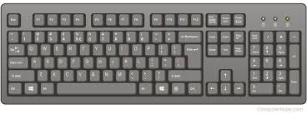
Basic I/O operation
input()
print()
Python 2.x - raw_input()
Python 3.x - input()

Slide 43
input()
input(“prompt message:”)
input() – program can prompt the user for input.
All input is stored as a string.

Slide 44
input()
Prompting for a value
Syntax :-
variable=input("prompt message")
>>> name=input("Enter your name:")
Enter your name:Karthik ⬅ user input

Slide 45
print()
The print() function prints the specified message to the monitor (STDOUT)
print(“message”)

Slide 46
Example 1
>>> name=input("Enter your name:")
Enter your name:karthik
>>> print(name)
karthik
>>>
>>> type(name)
<class 'str'>
>>>
>>> print("Hello...{}".format(name))
Hello...karthik

Slide 47
Example 2
>>> N=input("Enter any two digits:")
Enter any two digits:56
>>> print(N)
56
>>>
>>> type(N)
<class 'str'>
>>>N
>>>’56’

Slide 48
Prompting for numeric input
>>> N=int(input("Enter any two digits:"))
Enter any two digits:56
>>> print(N)
56
>>>
>>> type(N)
<class ‘int'>
>>>N
>>>56

Slide 49
Prompting for numeric input
>>> pi=float(input("Enter pi value:"))
Enter pi value: 3.15
>>> print(pi)
3.15
>>> type(pi)
<class ‘float'>

Slide 50

Activity
Q1. write a python program (Modify p1.py file )
Step 1: Create a new file : p2.py
Step 2: Read the employee details from <STDIN>
Step 3:Use type() & display input types <STDIN>
Step 4:Use print() & display employee details line by line

Slide 51
Activity
Q2. write a python program
Step 1 : create a filename p3.py
Step 2: Read an application name, application port number and service name from <STDIN>
Step 3: Use print() to display application details
Note : use escape chars to display application
details line by line

Slide 52
Lesson - 3

Slide 53
Operators
+ addition
- subtraction
/
// ( floor division – whole number)
** exponentiation
% modulus (remainder after division)‏
== != < <= > >= - Comparison operators
and or not – logical operators
in not in - membership operators
is is not identity operators

Slide 54
Operators
Example operators.py # python 2.x – examples print 2*2 print 2**3 print 10%3 print 1.0/2.0 print 1/2 Output: 4 8 1 0.5 0
Note the difference between floating point division and integer division in the last two lines

Slide 55
+= but not ++
Python has incorporated operators like +=,
but ++ (or --) do not work in Python

Slide 56

Activity
Write a python program
Step 1: create a filename p4.py
Step 2 : read any two disks partition name from <STDIN>
Step 3 : read an individual partition size from <STDIN>
Step 4: calculate sum of partition size
Step 5: use multiline statement & display input details in below format
Expected Result:
Python p4.py
Enter a disk partition: /dev/sda1
Enter /dev/sda1 partition Size: 100
Enter a disk partition:/dev/sda2
Enter /dev/sda2 partition Size:200
Partition /dev/sda1 Size : 100
Partition /dev/sda2 Size : 200
---------------------------------------------
Total Partition Size: 300
------------------------------------------------

Slide 57
String operators
s1="Welcome"
s2="Python"
print(s1+"to"+s2) # WelcometoPython
s1="welcome"
print(s1*3) # WelcomeWelcomeWelcome
count=1230
print("Total Sales count is:"+str(count))
# Total Sales count is:1230

Slide 58
Examples
s1= "sales"
s1 == "sales"
True
s1 == "SALES"
False
s1 != "SALES"
True

Slide 59
Activity
Predict the output of below expressions
Q1. “Admin” = = “admin”
Q2. 5062 > 5000
Q3. int(“60”) < int(“75”)
Q4. “Raj” != “raj”
Q5. float(“1.34”) > 0.045

Slide 60
Logical operators
Test more than one condition
Logical and operator
Logical or operator
Condition1 | Condition2 | Result
True | True | True
True | False | False
False | True | False
False | False | False
Condition1 | Condition2 | Result
True | True | True
True | False | True
False | True | True
False | False | False
Logical not operator
not True => False
not False => True

Slide 61
Logical operators
counter=560
counter >500 and counter<600
service=“apache2”
service == “apache2” or service == “httpd”
S=“root”
not S == “root”

Slide 62
Membership operators
in not in => True / False
“searchPattern” in inputString => True/False
“e” in “hello” => True
“E” in “hello” => False
“E” not in “hello” => True

Slide 63
Identity operators
‘is’ operator – Evaluates to true if the variables on either side of the operator point to the same object and false otherwise
x=100
type(x) is int
True
‘is not’ operator – Evaluates to false if the variables on either side of the operator point to the same object and true otherwise.
type(x) is str
False
type(x) is not str
True

Slide 64
Activity
Predict the result
Q1. sname=“xerox”
sname == “xerox” and sname == “XEROX”
Q2. port=6590
port >6000 and port <7000
Q3. app=“TestApp”
app=“testapp1” or app == “testapp” or app== “TestApp”

Slide 65
Python Conditional Statement
Testing (or) Validation (or) Decision making
Conditional code block will execute only one time.
Conditional statements are handled by if statements.

Slide 66
Python Conditional Statement
If statement we can write 3 ways
if only style
if ..else style
if .. elif…else style

Slide 67
Python Conditional Statement
What is if statement ?
if is a python keyword.
if statement is used for testing (or) decision making (or) validation.
if only style code block will run the body of code only when if statement is True.
How to use if only style?
Syntax:-
if(condition):
<---->True only block

Slide 68
Python Conditional Statement
>>> name="root"
>>> name == "root"
True
>>> if(name == "root"):
... print("Login is success")
...
Login is success
>>>
>>> name = "admin"
>>> name == "root"
False
>>> if(name == "root"):
... print("Login is success")
...
>>>

Slide 69
Python Conditional Statement
>>> count=50
>>>
>>> count>10
True
>>> if(count>10):
... print("valid count:{}".format(count))
...
valid count:50
>>>
>>> count<10
False
>>> if(count<10):
... print("valid count:{}".format(count))
...
>>>

Slide 70
if ..else statement
if(condition):
True block
else:
False block
>>> count=50
>>> count>100
False
>>> if(count>100):
... print("valid count:{}".format(count))
... else:
…. print(“invalid count:{}”.format(count))
invalid count:100
>>>

Slide 71
if ..elif statement
Multi conditional statement
if(condition1):
Trueblock1
elif(condition2):
Trueblock2
elif(condition3):
True block3
…
elif(condition N):
True block N
else:
False block

Slide 72
if ..elif statement
>>> name="root"
>>> if(name == "root"):
... print("Login name is:{}".format(name))
... elif(name == "userA"):
... print("Login name is:{}".format(name))
... elif(name == "userB"):
... print("Login name is:{}".format(name))
... else:
... print("Invalid login name")
...
Login name is:root
>>>

Slide 73
if ..elif statement
>>> name=“userA"
>>> if(name == "root"):
... print("Login name is:{}".format(name))
... elif(name == "userA"):
... print("Login name is:{}".format(name))
... elif(name == "userB"):
... print("Login name is:{}".format(name))
... else:
... print("Invalid login name")
...
Login name is:userA
>>>

Slide 74
if ..elif statement
>>> name=“userB"
>>> if(name == "root"):
... print("Login name is:{}".format(name))
... elif(name == "userA"):
... print("Login name is:{}".format(name))
... elif(name == "userB"):
... print("Login name is:{}".format(name))
... else:
... print("Invalid login name")
...
Login name is:userB
>>>

Slide 75
if ..elif statement
>>> name=“userC"
>>> if(name == "root"):
... print("Login name is:{}".format(name))
... elif(name == "userA"):
... print("Login name is:{}".format(name))
... elif(name == "userB"):
... print("Login name is:{}".format(name))
... else:
... print("Invalid login name")
...
Invalid login name
>>>

Slide 76
Activity
Step 1: create a file name p5.py
Step 2: Declare a variable name uname and initialize it with value “root”
Step 3: read a user name from <STDIN>
Step 4: Test if input user name matched with value in uname.
Step 5:If matched, display message “login is valid “ else display “login is invalid.”

Slide 77
Activity
Write a python program
Step 1: create a filename p6.py
Step 2: Read a port number from <STDIN>
Step 3: Test whether input port number range between 501-599
Step 4: If matched, initialize the application name as “Test-App1”.
Step 5: else display message “invalid port number.”

Slide 78
Activity
Write a python program –
Step 1: create file name p7.py
Step 2: Read a shell name from <STDIN>
Step 3: If input shell name is bash, initialize profile file name as “bashrc”
Step 4: If input shell name is ksh, initialize profile filename as “kshrc”
Step 5: If input shell name is psh, initialize profile filename as “winprofile”
Step 6:If neither of the shell name matches, Initialize with default shell name as “nologin” and profile file name as “/etc/profile”
Step 7 : Display shell name and shell profile filename

Slide 79
Python Looping statements
General loop is used to execute a block of statements or code several times until the given condition becomes false.
We use for loop when we know the number of times to iterate.
while – loop (Condition)
for – loop (Collection)

Slide 80
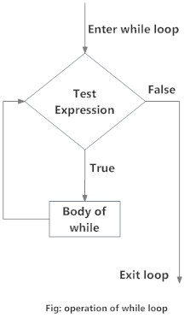
Python Looping statements
while loop
The while loop in Python is used to iterate over a block of code as long as the test expression (condition) is true.
Syntax:
while(condition):
<codeblock>

Slide 81
Python Looping statements
3 Points to remember
Initialization ➔ i=0
Condition ➔ while(i<5):
Increment/Decrement ➔ i=i+1

Slide 82
Python Looping statements
>>> i=0
>>> while(i<3): # 0 < 3 → True
print(“Hello…{}”.format(i))
i=i+1
Hello…0

Slide 83
Python Looping statements
>>> i=0
>>> while(i<3): # 1<3 → True
print(“Hello…{}”.format(i))
i=i+1
Hello…0
Hello…1

Slide 84
Python Looping statements
>>> i=0
>>> while(i<3): # 2<3 → True
print(“Hello…{}”.format(i))
i=i+1
Hello…0
Hello…1
Hello…2

Slide 85
Python Looping statements
>>> i=0
>>> while(i<3): 3<3 False → Exit from loop
print(“Hello…{}”.format(i))
i=i+1
Hello…0
Hello…1
Hello…2
>>>

Slide 86
Python Looping statements
For loops are used for sequential traversal.
Syntax:-
for variable in collection:
code block(s)
Example:-
for v in “abcd”:
print(“Hello..{}”.format(v))
Hello..’a’
Hello..’b’
Hello..’c’
Hello..’d’

Slide 87
break ; continue
break - exit from loop
continue - continue from next element

Slide 88
Activity
Write a program:
Step 1: create a file name p8.py
Step 2: declare & initialize the pin number (ex: pin=1234)
Step 3: Use while loop to iterate following statement thrice
(i) Read a pin number from <STDIN>
(ii) Compare a input pin with existing pin number
(iii) If both pin numbers are matched , display pin number is matched at count time & exit from loop.
(iv) If all 3 attempts fails, display message “ your pin is blocked.”

Slide 89
Activity
Step 1: create a file name: p9.py
Given String
S=“123456578”
Step 2: Calculate sum of numbers
Note : use for loop

Slide 90
Activity
Write a python program
Step 1: create a new file p10.py
Step 2: Modify the below code using while loop
s=“abcd”
for var in s:
print(var)
Step 3: Display list of characters one by one

Slide 91
Lesson - 5

Slide 92
Python - Collections
List ( list - [ ] )
Tuple ( tuple – () )
Dictionary ( dict – { } )
Set (set)

Slide 93
List
Lists are just like dynamic sized arrays, declared in other languages.
List are ordered elements
A single list may contain mixed data types.
Lists are mutable, and hence, they can be altered even after their creation.

Slide 94
List
The elements in a list are indexed according to a definite sequence and the indexing of a list is done with 0 being the first index.
Each element in the list has its definite place in the list, which allows duplicating of elements in the list, with each element having its own distinct place and credibility.
List supports indexing and slicing

Slide 95
List - Examples
Listname=[] # Creating a list
DB=[‘oracle’,’sql’,’plsql’,’mysql’,’sqlite3’]
Emp=[‘arun’,’sales’,133,1323.23,True]

Slide 96
Example
L=['D1', 10, 3.45,True,None ]
# 0 1 2 3 4 <== index
# -5 -4 -3 -2 -1<== index
type(L) => <class ‘list’)
type(L[0]) => <class ‘str’>
len(L) => 5

Slide 97
List – Index and Slicing
Files=[‘p1.c’ ,’p2.java’,’p3.cpp’,’p4.py’,’repo.log’]
# 0 1 2 3 4 ⬅ index
Files[1] # ‘p2.java’
Files[1:4] # [ ‘p2.java’, ’p3.cpp’, ’p4.py’ ]
Files[:2] # [ ’p3.cpp’, ’p4.py’, ’repo.log’ ]

Slide 98
Membership operators
# "searchString" in inputList ->True/False
fnames=["p1.log","p2.log","p3.log","test.log"]
if("p3.log" in fnames):
print("Yes file p3.log is exists")
else:
print("Sorry file is not exists")

Slide 99
List methods
Listname.append(Value)
(or)
Listname.insert(index,Value)
# we can add new data to existing list
Listname.pop(Index)
# we can delete nth data from existing list
Listname[index]=updated_value
# we can modify existing nth data from list

Slide 100
Example
L=[]
print(len(L))
# Listname.append(Value) =>None
L.append("p1.log")
L.append(100)
L.append(3.45)
L.append(True)
print(L) => [‘p1.log’,100,3.45,True]

Slide 101
List methods
Listname.pop()
Listname.insert(Index,Value)
Listname.index(Value)
Listname.count(value)

Slide 102
Activity
Q1. write a python program
Step 1 : Create a file name : p11.py
Step 2: create an empty list
Step 3: display size of list
Step 4: use while loop 5 times
i) To read a hostname from <STDIN>
ii) To add a input hostname to existing list
Step 5: using for loop, display list of elements
Step 6: display size of the list

Slide 103
Activity
Q2. write a python program
Given List
DBs=[‘oracle’,’sql’,’mysql’,’plsql’]
Step 1: create a file name : p12.py
Step 2: read a database name from <STDIN>
Step 3: test input database name is existing or not
Step 4: if input DB name exists, using index(), display index number
Step 5: If input DB does not exist, add the input DB name to the existing list.
Step 6: display list line by line using for loop

Slide 104
Activity
Q3. write a python program
Given List
Step 1: create a filename p13.py
LB=[‘0.13’,’14.4’,’1.34’,’3.24’,’2.44’]
Step 2: Calculate sum of load balance

Slide 105
Tuple
Tuple – Collection of elements like list
The difference between the two is that we cannot change the elements of a tuple once it is assigned whereas we can change the elements of a list.
i.e., tuple is immutable
type(( )) Vs type([])

Slide 106
Tuple
Syntax:-
tuplename=(list of elements)
tname=(10,20.45,”data”,True)
len(tname) => 4

Slide 107
Tuple
A tuple can also be created without using parentheses. This is known as tuple packing.
V1=10
type(V1) => <class ‘int’>
V2=10,
type(V2) => <class ‘tuple’>

Slide 108
Iterating Through a list/tuple
F=[‘p1.log’,’p2.log’,’p3.log’]
for var in F:
print(var)
p1.log
p2.log
p3.log
servers=(“unix”,”linux”,”aix”)
for var in servers:
print(var)
unix
linux
aix

Slide 109
Tuple operations
tuple supports indexing and slicing
tuple supports membership in not in operators.
We typecast list to tuple vice versa
tuple(input_List)
list(input_tuple)

Slide 110
Deleting a Tuple
we cannot change the elements in a tuple. It means that we cannot delete or remove items from a tuple.
Deleting a tuple entirely, however, is possible using the function del().
del(tuple_name)

Slide 111
Tuple usages in python
Since tuples are immutable, iterating through a tuple is faster than with list. So there is a slight performance boost.
Tuples that contain immutable elements can be used as a key for a dictionary. With lists, this is not possible.
If you have data that doesn't change, implementing it as tuple will guarantee that it remains write-protected.
tuple() type of structures used in functions

Slide 112
Activity
Predict the error message
Q1. T=(1,2.3,’D1’)
T[1]=“data1”
Q2. T=(10,20,30,40,50)
print(T[-6])
Q3. T=(1,2)
del(T[1])

Slide 113
Activity
Q1. Write a python program
Step 1: create a filename p14.py
Given tuple
Products=(“P1”,”P2”,”P3”,”P4”,”P5”)
Step 2: display the list of products except P2 and P3
Note :use for loop statement

Slide 114
Activity
Write a python program
Step 1: create a filename p15.py
Given Tuple :
EMP=(‘101,leo,sales,1000’,’102,paul,prod,2000,’103,raj,HR,3000’)
Step 2: use for loop along with split() to get the following expected result.
Expected result:-
Emp name is leo working department is sales
Emp name is paul working department is prod
Emp name is raj working department is HR
---------------------------------------------------------
Sum of Emp’s cost is: 6000
----------------------------------------------------------

Slide 115
Lesson - 6

Slide 116
Dictionary
Python dictionary is an unordered collection of items.
Syntax:-
dict_name={“key1”:Value,”Key2”:Value,..”Kn”:”Vn”}
Data – {‘Key’ : Value }
app={“port”:80,”service”:”apache2”}
Key | Value
port | 80
service | apache2

Slide 117
dict- operations
# Accessing Elements from Dictionary dict_name[‘Key’] → Value / KeyError
# adding newdata to existing dictionary
dict_name[‘NewKey’]=Value
# modifying existing dictionary element
dict_name[‘ExistingKey’]=Updated_value
# deleting nth element
del(dict_name[‘Key’])

Slide 118
Activity
Step 1 - Open a python shell
Step 2 - create an empty dict (ex: d={})
Step 3 - read a hostname from <STDIN>
read an IPAddress from <STDIN>
Step 4 - add a input details to existing dict
with hostname as a key and IPAddress as its value
Step 5 - display dictionary and it’s size

Slide 119
dict- methods
dict.get(Key)
dict.setdefault(Key,Value)
dict.pop(“key”)
dict.keys()

Slide 120
Activity
Write a python program
Step 1 : create a file name: p16.py
Step 2 : create an empty dict
Step 3 : use looping statements – 5times
i) Read a hostname from <STDIN>
ii) Read a IP-Address from <STDIN>
iii) Add a input details to existing dict
iv) with hostname as a key and IP address as it’s value
Step 4 : display Key/ value details to monitor

Slide 121
Dictionary Membership Test
We can test if a key is in a dictionary or not using the keyword in.
Note that the membership test is only for the keys and not for the values.
“key” in input_dictionary → True/False

Slide 122
Activity
Write a python program – modify p16.py file
Step 1: create a new file p17.py
Step 2: Use membership operator to test whether the input hostname already exists or not.
Step 3: if it’s exists already, display pop up message “Sorry your input hostname is exist”.

Slide 123
Iterating Through a Dictionary
We can iterate through each key in a dictionary using a for loop.
d={“K1”:”V1”,”K2”:”V2”,”K3”:”V3”}
for var in d:
print(var)
K1
K2
K3

Slide 124
Activity
Write a python program
Step 1 : create a new file p18.py with existing code of p17.py
Step 2: Using for loop – display key /value details
i.e., hostname and IP-Address details

Slide 125
set
A set is an unordered collection of items. Every element is unique (no duplicates) and must be immutable (which cannot be changed)
Sets can be used to perform mathematical set operations like union, intersection, symmetric difference etc.

Slide 126
How to create a set?
A set is created by placing all the items (elements) inside curly braces {}, separated by comma or by using the built-in function set().
var={1,2,3,4,"Data1","Data2"}
>>> type(var)
<class 'set'>
>>> v1=set()
>>> type(v1)
<class 'set'>

Slide 127
Empty set
To make a set without any elements we use the set() function without any argument.
var={}
type(var)
<class 'dict'> ⬅ dictionary
v1=set()
type(v1)
<class 'set'>
len(v1)
0

Slide 128
Every element is unique (no duplicates) and
must be immutable (which cannot be changed).
>>> v2={10,20,30,10,20,"DATA1","data1","DATA1"}
>>> print(v2)
{10, 'DATA1', 'data1', 20, 30} # there is no duplicate element

Slide 129
We cannot access or change an element of set using indexing or slicing. set does not support it.
v2={10,20,30}
type(v2)
<class 'set'>
>>> v2[0] ⬅
Traceback (most recent call last):
File "<stdin>", line 1, in <module>
TypeError: 'set' object does not support indexing
>>> print(v2)
{10, 20, 30}

Slide 130
How to change a set in Python?
set are unordered, indexing have no meaning.
We cannot access or change an element of set using indexing or slicing.
We can add single element using the add() method and multiple elements using the update() method.
The update() method can take tuples, lists, strings or other sets as its argument.

Slide 131
add() vs update()
>>> v3={"Data1","Data2","Data3"}
>>>
>>> len(v3)
3
>>> print(v3)
{'Data1', 'Data2', 'Data3'}
>>>
>>>
>>> v3.add("Data4")
>>> v3
{'Data1', 'Data2', 'Data4', 'Data3'}
>>>
>>> v3.add("Data4")
>>> v3
{'Data1', 'Data2', 'Data4', 'Data3'}
>>>
>>> # avoiding duplicate entry
...
>>> v4={"Text1","Text2"}
>>>
>>> v4.update(["Text3\n","Text4\n","Text5\n"])
>>> v4
{'Text1', 'Text2', 'Text3\n', 'Text5\n', 'Text4\n'}
>>>
>>> v4.update(("Text3\n","Text4\n","Text6\n"))
>>>
>>> v4
{'Text1', 'Text2', 'Text6\n', 'Text3\n', 'Text5\n', 'Text4\n'}
>>>
>>> len(v4)
6

Slide 132
How to remove elements from a set?
A particular item can be removed from set using methods, discard() and remove().
while using discard() if the item does not exist in the set, it remains unchanged.
But remove() will raise an error in such condition.

Slide 133
remove() vs discard()
>>> v3={"Data1","Data2","Data3"}
>>>
>>> len(v3)
3
>>> print(v3)
{'Data1', 'Data2', 'Data3'}
>>>
>>>
>>> v3.remove("Data3")
>>> v3
{'Data1', 'Data2'}
>>>
>>> v3.remove("Data7")
>>> traceback (most recent call last):
File "<stdin>", line 1, in <module>
eyError: 'data7'
>>> v4={"Text1","Text2"}
>>>
>>> v4.discard(“Text2”)
>>> v4
{'Text1‘}
>>>
>>> v4.discard(“Text5”)
>>>
>>> v4
{'Text1’}

Slide 134
Python Set Operations
Sets can be used to carry out mathematical set operations like union, intersection, difference and symmetric difference.
We can do this with operators or methods.
A = {1, 2, 3, 4, 5}
B = {4, 5, 6, 7, 8}

Slide 135
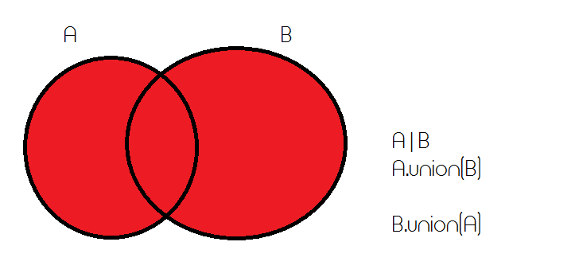
Set Union
>>> A={1,2,3,4,5}
>>>
>>> B={1,2,3,6,7,8,9}
>>>
>>> A.union(B)
{1, 2, 3, 4, 5, 6, 7, 8, 9}
>>>
>>> B.union(A)
{1, 2, 3, 4, 5, 6, 7, 8, 9}
>>>
>>> A|B
{1, 2, 3, 4, 5, 6, 7, 8, 9}
>>>
>>> B|A
{1, 2, 3, 4, 5, 6, 7, 8, 9}
>>>

Slide 136
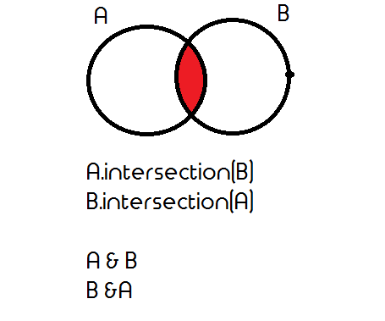
Set Intersection
>>> A={1,2,3,4,5}
>>> B={1,2,3,6,7,8,9}
>>>
>>> A&B
{1, 2, 3}
>>>
>>> B&A
{1, 2, 3}
>>>
>>> A.intersection(B)
{1, 2, 3}
>>>
>>> B.intersection(A)
{1, 2, 3}

Slide 137
Activity
Q1. open a python shell
C={“p1.c”,”p2.c”,”p3.java”,”Demo”}
D={“p1.java”,”p1.c”,”p3.java”,”p2.c”,”Demo”,”D1”}
Filter common files from the above two sets
Combine both sets into single set and omit duplicate elements.
type cast to list

Slide 138
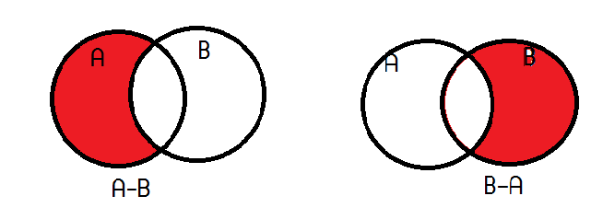
Set Difference
Difference of A and B (A - B) is a set of elements that are only in A but not in B. Similarly, B - A is a set of element in B but not in A.

Slide 139
set difference
>>> A={1,2,3,4,5}
>>> B={1,2,3,6,7,8,9}
>>>
>>> A-B
{4, 5}
>>> B-A
{8, 9, 6, 7}
>>>
>>> A.difference(B)
{4, 5}
>>>
>>> B.difference(A)
{8, 9, 6, 7}
>>>

Slide 140
Set Symmetric Difference
Symmetric Difference of A and B is a set of elements in both A and B except those that are common in both.
Symmetric difference is performed using ^ operator.
Same can be accomplished using the method symmetric_difference().

Slide 141
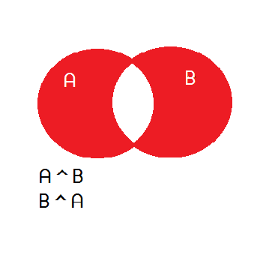
Set Symmetric Difference
>>> A={1,2,3,4,5}
>>>
>>> B={1,2,3,6,7,8,9}
>>>
>>> A^B
{4, 5, 6, 7, 8, 9}
>>>
>>> B^A
{4, 5, 6, 7, 8, 9}
>>>
>>> A.symmetric_difference(B)
{4, 5, 6, 7, 8, 9}
>>>
>>> B.symmetric_difference(A)
{4, 5, 6, 7, 8, 9}
>>>

Slide 142
Activity
Predict the result of below set operations
S1={‘data1’,’data2’,’data3’}
S2={‘data2’,’data3’,’data4’,’data5’}
print(S1-S2)
print(S2-S1)
print(S1 ^ S2)

Slide 143
Lesson - 7

Slide 144
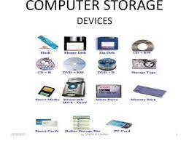
File Handling
input()
print()

Slide 145
File categories
Reading data from <FILE> → Python → display to monitor
Python → Create / Write data to FILE
Reading data from <FILE> → Python → Create/Write data to another FILE

Slide 146
File – read operation
Open a file => fileobject=open(inputfile,mode)
|
Read content fileobject.read() / fileobject.readlines()
|
Close a file => fileobject.close()

Slide 147
File – create/write operation
Open a file => fileobject=open(result_file,”w”)
# w – write ; a –append
|
Read content fileobject.write( “InputString\n”)
|
Close a file => fileobject.close()

Slide 148
File – read/write operation
FH=Open(“inputFile”,”r”)
WH=open(“resultFile”,”w”)
S=FH.read()
WH.write(S+”\n”)
FH.close()
WH.close()

Slide 149
Activity
Write a python program
Step 1: Create a filename p19.py
Step 2: Read an existing TEXT file from your disk
Step 3: Display file content line by line.

Slide 150
Activity
Write a python program
Step 1 : create a filename p20.py
Step 2 : create a new emp.csv file under D:\\
Step 3 : write any 5 sample csv content to emp.csv file
Step 4 : close the file

Slide 151
Activity
Write a python program
create a filename p21.py to demonstrate the cp command
Syntax:
cp oldfile newfile

Slide 152
with statement in python
with open(“inputFile”,”r”) as fileobject:
fileobject.read() / fileobject.readlines()
with open(“resultFile”,”w”) as fileobject:
fileobject.write(“Single String\n”)
Note : fileobject.close() note required
Notes:
with open("D:\\test.log") as FH:
s=FH.read()
print(s)
with open("D:\\result.log") as WH:
WH.write("data1\n")
WH.write("data2\n")
WH.write("data3\n")
with open("D:\\test.log") as FH:
with open("D:\\r1.log","w") as WH:
for var in FH.readlines():
WH.write(var)

Slide 153
Examples
with open("D:\\test.log") as FH:
s=FH.read()
print(s)
Reading data from <FILE>
with open("D:\\result.log“,”w”) as WH:
WH.write("data1\n")
WH.write("data2\n")
WH.write("data3\n")
Create/writing data to FILE
with open("D:\\test.log") as FH:
with open("D:\\r1.log","w") as WH:
for var in FH.readlines():
WH.write(var)
Read/write operation

Slide 154
Activity
Write a python program
Step 1 : Create a filename p22.py
Step 2 : Use with statement to modify p20.py and p21.py program

Slide 155
Activity
Write a python program
Step 1 : create a filename p23.py
Given List
Net=[‘interface=eth0’,’bootproto=dhcp’,’onboot=none’]
Step 2 : create a new file called property.txt
Step 3 : iterate a given list one by one
Step 4 : write list element into property file
Note : use with statement

Slide 156
Activity
Write a python program
Step 1 : create a filename: p24.py
Step 2 : create an empty dict
Step 3 : read a existing property.txt file (read line by line)
Split each line into multiple values
Key = value
Add the split data to existing dictionary
Step 4: use for loop – display key/value details
Step 5: modify following operation
Onboot -> yes ; bootproto -> static ;
Add new IP-address ex: IPADDR=10.20.30.40
Step 6: display key/value details (Step 4 )
Step 7: create a new property file( p1.txt) and write updated dictionary details in same format.

Slide 157
Lesson - 8

Slide 158
What is a function in Python?
In Python, function is a group of statements that perform a specific task.
Functions help break our program into smaller and modular chunks.

Slide 159
Syntax of Function
def function_name(parameters):
"""docstring"""
statement(s)
Keyword def marks the start of function header.
A function name to uniquely identify it.
Function naming follows the same rules of writing identifiers in Python.
Parameters (arguments) through which we pass values to a function.
A colon (:) to mark the end of function header.
Optional documentation string (docstring) to describe what the function does.
One or more valid python statements that make up the function body. Statements must have same indentation level.
An optional return statement to return a value from the function.

Slide 160
How to call a function in python?
Once we have defined a function, we can call it from another function, program or even the Python prompt.
To call a function we simply type the function name with appropriate parameters.
function_name()

Slide 161
Example
>>> def display():
... print("Hello I am display block")
...
>>> type(display)
<class 'function'>
>>>
>>> display
<function display at 0x02287108>
>>> display()
Hello I am display block
>>>

Slide 162

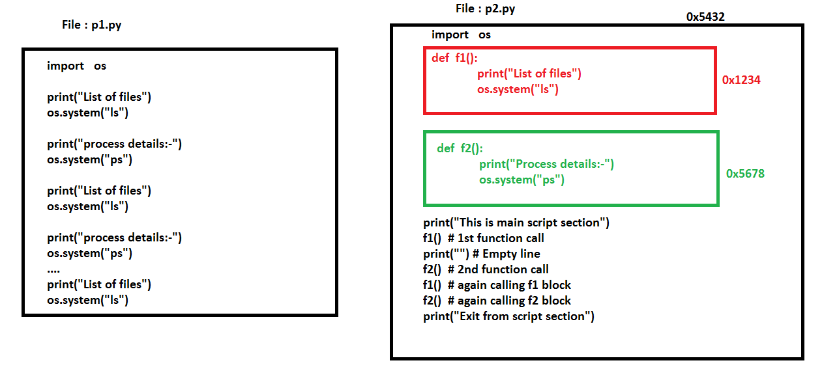

Slide 163
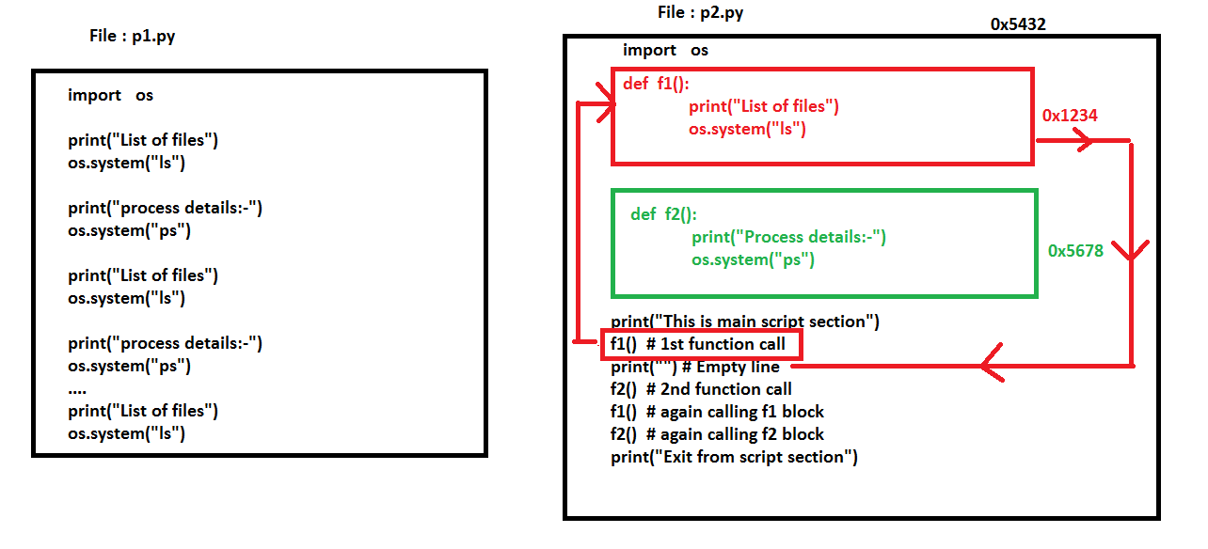

Slide 164
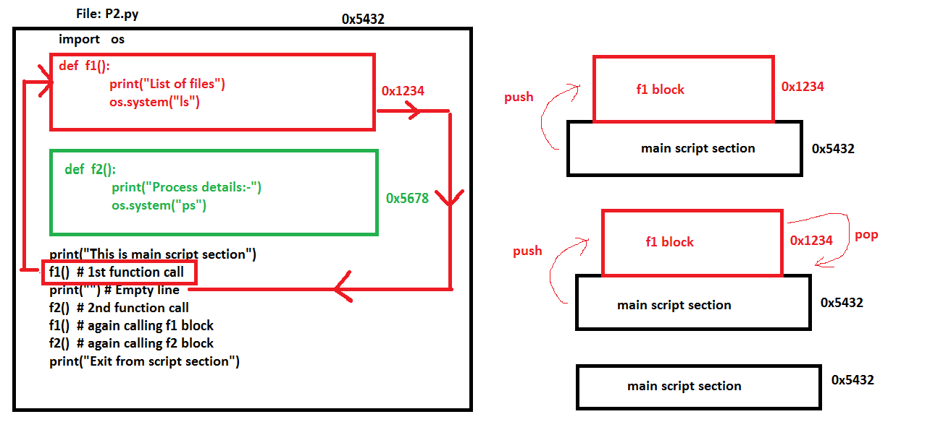
1
2
1
2

Slide 165
Function call with arguments
In function call, we can pass any type of values as arguments.
Syntax :-
def function_name(arg1,arg2,arg3):
Code block
function_name(Value1,Value2,Value3)
# function call with arguments

Slide 166
Function call with arguments
>>> def f1(a1,a2):
... print("Function call with arguments")
... print(type(a1))
... print(type(a2))
... print("Exit from function")
>>> f1(10,2.45)
Function call with arguments
<class 'int'>
<class 'float'>
Exit from function
>>>
>>> f1("abc",[])
Function call with arguments
<class 'str'>
<class 'list'>
Exit from function
>>> f1((),{})
Function call with arguments
<class 'tuple'>
<class 'dict'>
Exit from function
>>>
>>> f1({"S1","S2"},[])
Function call with arguments
<class 'set'>
<class 'list'>
Exit from function
>>>

Slide 167
Function call with arguments
We can call a function by using the following types of
formal arguments-
Required arguments def f1(a1,a2,…an)
Default arguments def f2(variable=value)
Variable-length arguments def f3(*args)
Keyword arguments def f4(**kwargs)

Slide 168
Function call with arguments
Required Arguments
Required arguments are the arguments passed to a function in correct positional order.
Here, the number of arguments in the function call should match exactly with the function definition.
Example
def f1(a1,a2):
print("a1 value:{}\ta2 value:{}".format(a1,a2))
f1(10,1.334) # function call with 2 arguments(int,float)
a1 value:10 a2 value:1.334
f1("AB",["D1","D2","D3"]) # function call with 2 arguments(str,list)
a1 value:AB a2 value:['D1', 'D2', 'D3']

Slide 169
Function call with arguments
Default Arguments
A default argument is an argument that assumes a default value if a value is not provided in the function call for that argument.
def function_name(var=value):
code block

Slide 170
Function call with arguments
>>> def f2 (a1=10,a2=2.46):
... print(a1,a2)
...
>>> f2() # empty args
10 2.46
>>> f2("AB") # single args
AB 2.46
>>> f2("AB","SAB")
AB SAB
>>> def f3(user="root",port=22):
... print(user,port)
...
>>> f3() # empty args
root 22
>>> f3("userA") # single args
userA 22
>>> f3("userA",120)
userA 120

Slide 171
def display (user,passwd, ip="127.0.0.1",port=22):
print("Login name:{}".format(user))
print("Password:{}".format(passwd))
print("IP-Address:{}".format(ip))
print("PORT Number:{}".format(port))
display("userA","Welcome") # required arguments
Login name:userA
Password:Welcome
IP-Address:127.0.0.1
PORT Number:22
display("userA","Welcome","10.20.30.40") # required arguments and default args
Login name:userA
Password:Welcome
IP-Address:10.20.30.40
PORT Number:22
display("userA","Welcome","10.20.30.40",1240) # required arguments and default args
Login name:userA
Password:Welcome
IP-Address:10.20.30.40
PORT Number:1240

Slide 172
Function call with arguments
Variable-length Arguments
You may need to process a function for more arguments than you specified while defining the function.
These arguments are called variable-length arguments and are not named in the function definition, unlike required and default arguments.
def f1(*args):
code block

Slide 173
>>> def f1(*a1): # variable length arguments
... print(type(a1))
... print(a1)
...
>>>
>>> f1() # call with empty argument
<class 'tuple'>
()
>>> f1(10,2.34,"data") # call with args
<class 'tuple'>
(10, 2.34, 'data')
>>>
>>> f1(10,2.34,"data",["D1","D2","D3"]) # call with args
<class 'tuple'>
(10, 2.34, 'data', ['D1', 'D2', 'D3'])
>>>

Slide 174
>>> def f1(a1,a2=100,*a3): # required args,defaultargs,variablelength args
... print("A1:{}".format(a1)) # required args
... print("A2:{}".format(a2)) # default value
... print("A3:{}".format(a3)) # variable length args-tuple
>>> f1("ab")
A1:ab
A2:100
A3:()
>>> f1("ab","Test")
A1:ab
A2:Test
A3:()
>>> f1("ab","Test","report1","report2","report3")
A1:ab
A2:Test
A3:('report1', 'report2', 'report3')

Slide 175
Function call with arguments
Keyword Arguments
Keyword arguments are related to the function calls. When you use keyword arguments in a function call, the caller identifies the arguments by the parameter name.
This allows you to skip arguments or place them out of order because the Python interpreter is able to use the keywords provided to match the values with parameters.

Slide 176
Function call with arguments
Keyword Arguments
def f1(**kwargs):
code block
f1(variable=value)

Slide 177

>>> def f1(**a1): # keyword arguments
... print(type(a1))
... print(a1)
>>>
>>> f1() # empty argument
<class 'dict'>
{}
>>>
>>> f1(name="root",db="mysql",user="root") # keyword arguments
<class 'dict'>
{'name': 'root', 'db': 'mysql', 'user': 'root'}
>>>
>>> def f1(**kwargs):
... for v in kwargs.keys():
... print("{}\t{}".format(v,kwargs[v]))
>>> f1(name="root",db="mysql",user="root") # keyword arguments
name root
db mysql
user root

Slide 178
>>> def display(a1,a2=100,*a3,**a4):
... print(a1) # required argument
... print(a2) # default argument
... print(a3) # variable length args
... print(a4) # keyword argument
...
>>> display("AB") # required argument
AB
100
()
{}
>>> display("AB","TEST1") # required and default argument
AB
TEST1
()
{}
>>> display("AB","TEST1","TEST2","TEST3","TEST4")
AB
TEST1
('TEST2', 'TEST3', 'TEST4')
{}
display ("AB","Test1","Test2","Test3","Test4",user="root",passwd="Welcome",port=80)
AB
Test1
('Test2', 'Test3', 'Test4')
{'user': 'root', 'passwd': 'Welcome', 'port': 80}
>>>

Slide 179
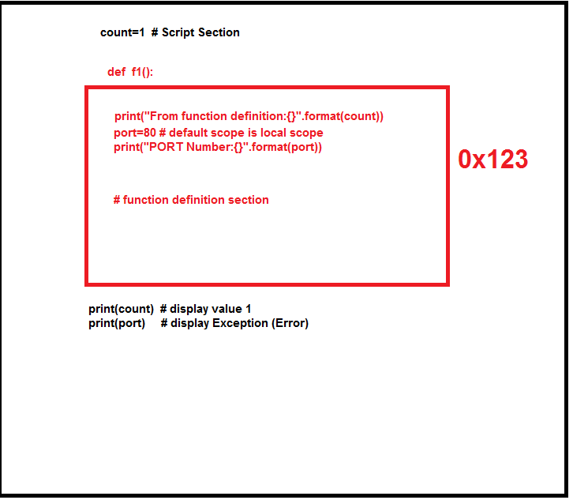
Scope
count=1 # Script section
def f1():
print("From function definition:{}".format(count))
port=80 # default scope is local scope
print("PORT Number:{}".format(port))
f1() # function call
From function definition:1
PORT Number:80
>>> port # variable port is not defined in script section
Traceback (most recent call last):
File "<stdin>", line 1, in <module>
NameError: name 'port' is not defined
>>>

Slide 180
global
global keyword is a keyword that allows a user to modify a variable outside of the current scope.
global keyword is used inside a function only when we want to do assignments or when we want to change a variable.

Slide 181
Rules of global keyword
If a variable is assigned a value anywhere within the function’s body, it’s assumed to be a local unless explicitly declared as global.
Variables that are only referenced inside a function are implicitly global.
We Use global keyword to use a global variable inside a function.
There is no need to use global keyword outside a function.
>>> def f1():
... global port
... port=80
...
>>> f1() # function call
>>> print(port) # global value
80
>>>

Slide 182
return
A return statement is used to end the execution of the function call and “returns” the result (value of the expression following the return keyword) to the caller.
return statement can not be used outside the function.
In python default return value is None.
>>> def f1():
... print("Hello")
>>> rv=f1()
Hello
>>> rv == None
True
>>>

Slide 183
python supports all types of return values
>>> def f1():
... return "abc" # string
...
>>> f1()
'abc‘
>>> def f2():
... return 1.355 # float
...
>>> f2()
1.355
>>> def f3():
... return True # boolean
...
>>> f3()
True
>>> def f4():
... return ["D1","D2","D3"] # list
...
>>> f4()
['D1', 'D2', 'D3']
>>> def f5():
... return ("T1","T2") # tuple
...
>>> f5()
('T1', 'T2')
>>> def f6():
... return {"K1":"V1","K2":"V2"} # dict
...
>>> f6()
{'K1': 'V1', 'K2': 'V2'}
>>>
>>> def f7():
... return {"K1","K2",12,3,4,5.45} # set
...
>>> f7()
{3, 4, 'K2', 12, 'K1', 5.45}
>>>

Slide 184
Returning Multiple Values
In Python, we can return multiple values from a function.
In python function returns more than one value means the default type will be tuple(immutable).
>>> def f1():
... return 10
...
>>> type(f1())
<class 'int'>
>>>
>>> def f1():
... return 10, # more than one value,separated by ,(comma)
...
>>> type(f1())
<class 'tuple'>
>>>

Slide 185
>>> def f1():
... return 10,3.45,"ab",["D1","D2"],("T1","T2"),{"K1":"V"}
...
>>> type(f1())
<class 'tuple'>
>>> f1()
(10, 3.45, 'ab', ['D1', 'D2'], ('T1', 'T2'), {'K1': 'V'})

Slide 186
Activity - identify the errors
Q1. def f1(a1,a2):
print("Hello")
f1(10,20,None)
Q2. def f2(a1,a2,a3=0,a4):
print("Hello")
f2(100,200,300,400)
Q3. def f3(a1,a2,a3=0):
print("Hello")
f3(10)
Q4. def f4(a1,a2=0,*a3,*a4):
print("Hello")
f4(10)
Q5. def f5(**a2,*a3):
print("Hello")
f5()

Slide 187
Activity
Write a python program
Step 1: create a filename p25.py file by modifying p24.py
Step 2: Convert each step into separate function
Note: Declare local variable inside the function and return the processed value

Slide 188
Lesson - 9

Slide 189
Python Modules
Python module is existing python source file
Filename extension must be .py
A module can also include runnable code.
Reusability

Slide 190
Module basics
Each file in Python is considered a module.
Everything within the file is encapsulated within a namespace (which is the name of the file)‏
To access code in another module (file), import that file, and then access the functions or data of that module by prefixing with the name of the module, followed by a period.

Slide 191
File : ab.py
=============
port=80
service=“httpd”
def fx():
return 10
==============
File: p3.py
import ab
rv=ab.fx()
print(“rv={}”.format(rv))
File : p1.py
import ab
print (ab.port)
File: p2.py
import ab
print(ab.port)
print(ab.service)
Notes:
There is no suffix

Slide 192
What import does
An import statement does three things:
- Finds the file for the given module - Compiles it to byte code - Runs the module's code to build any objects (top-level code, e.g., variable initialization)‏
env variable PYTHONPATH

Slide 193
Activity
Step 1: Create a new file p26.py by modifying p25.py file
Step 2: remove all function calls.
Step 3: open a python shell and import p26.py file into current working shell
Use help() – understand module docs

Slide 194
Python standard library
import os
os.system(“command”)
os.system(“dir”)
os.system(“ps –e|grep bash”)
os.popen(“dir”).read()
os.popen(“dir”).readlines()
os.listdir(“.”)
os.mkdir(“dirName”)
os.chdir(“dirName”)
help(os)
import sys
sys.version
sys.path
sys.modules
sys.argv
sys.exit()
sys.stdin
sys.stdout
help(sys)

Slide 195
Activity
Step 1: Open a python shell
Step 2: Import os module (import os)
Step 3: Display following information
Display working directory
Display list of files under current directory and count the total no.of files under current directory
Display your running python shell process ID(PID)

Slide 196
Activity
Write a python program
Create a new file p27.py
File :pa.py
ip1=int(input(“Enter a IP1 value:”))
ip2=int(input(“Enter a IP2 value:”))
total=ip1+ip2
Print(“Sum of ip1 and ip2 value:{}”.format(total))
Modify the above code with command line arguments.

Slide 197
Python standard library
import math
import pprint
import json
import re
import time
import cProfile
More standard module refer this URL
The Python Standard Library — Python 3.9.5 documentation

Slide 198
import vs from ... import
import brings in a whole module; you need to qualify the names by the module name (e.g., sys.argv)‏
“import from” copies names from the module into the current module; no need to qualify them (note: these are copies, not links, to the original names) from module_x import junk junk() # not module_x.junk() from module_x import * # gets all top-level # names from module_x

Slide 199
Module Packages
When using import, we can give a directory path instead of a simple name. A directory of Python code is known as a “package”: import dir1.dir2.module or from dir1.dir2.module import x will look for a file dir1/dir2/module.py
Note: dir1 must be within one of the directories in the PYTHONPATH
Note: dir1 and dir2 must be simple names, not using platform-specific syntax (e.g., no C:\)‏

Slide 200
Python pip

Slide 201
What is Pip?
pip is a tool for installing and managing Python packages.
pip can be install on various operation systems: Linux, Mac, Windows, etc

Slide 202
How to install <module> in winx?
C:\Users\User>python -m pip install fabric
Requirement already satisfied: fabric in c:\users\user\appdata\local\programs\p
site-packages (2.4.0)

Slide 203
Install Pip on MacOS
Install pip on MacOS, using easy_install command and upgrade pip to the latest version:
sudo easy_install pip
sudo pip install --upgrade pip

Slide 204
get-pip.py
For mac os , easy_install has been deprecated.
First of all download the get-pip file
curl https://bootstrap.pypa.io/get-pip.py -o get-pip.py
python get-pip.py # run this file to install pip

Slide 205
Install Pip in Ubuntu
Install pip in Ubuntu, using apt-get package manager:
sudo apt-get update
sudo apt-get install python-pip
sudo pip install --upgrade pip

Slide 206
Install Pip in CentOS
Install pip in CentOS from EPEL repository, using yum package manager:
sudo yum update
sudo yum install epel-release
sudo yum install python-pip
# CentOS-7 and higher
sudo pip install --upgrade pip
# CentOS-6 (the last stable version of PIP that is compatible with Python 2.6)
sudo pip install pip==9.0.3

Slide 207
To list all modules
pydoc modules
>>> help('modules')
# print all names exported by the module print(dir(module))

Slide 208
Lesson - 10

Slide 209
Python Errors & Exceptions
Syntax errors
2. Logical errors (Exceptions)

Slide 210
Python Logical Errors (Exceptions)
Errors that occur at runtime (after passing the syntax test) are called exceptions or logical errors.
We can view all the built-in exceptions using the built-in local() function as follows:
print(dir(locals()['__builtins__']))

Slide 211
Exceptions in Python
Python has many built-in exceptions that are raised when your program encounters an error
When these exceptions occur, the Python interpreter stops the current process and passes it to the calling process until it is handled. If not handled, the program will crash.

Slide 212
Exception block
try:
code block
except Exception as eobj:
Handle Exception
else:
There is no Exception
finally:
Always running

Slide 213
Example
try:
var=100
print(VAR)
except Exception as eobj:
print(eobj)
print("List of files:-")
for v in os.listdir("."):
print(v)
print("Exit from script")
var=100
print(VAR)
print("List of files:-")
for v in os.listdir("."):
print(v)
print("Exit from script")

Slide 214
Raising Exceptions in Python
In Python programming, exceptions are raised when errors occur at runtime.
We can also manually raise exceptions using the raise keyword.
>>> try:
... n=input("Enter a login name:")
... if n != "root":
... raise NameError ("Sorry your login name is not matched")
... except Exception as eobj:
... print(eobj)
...
Enter a login name:asfdsad
Sorry your login name is not matched

Slide 215
Activity
Write a python program
create a new file p28.py
Handle the exceptions in the following cases
Case 1:
port=8080
print(PORT)
Case 2:
F=Open(“invalid file”)
F.readlines()
F.close()
Case 3:
import openpyxl
Module Not Found

Slide 216
Lesson - 11

Slide 217
Functional Style programming
Functional programming decomposes a problem into a set of functions.
Ideally, functions only take inputs and produce outputs, and don’t have any internal state that affects the output produced for a given input.
Well-known functional languages include the ML family.
Every function's output must only depend on its input.

Slide 218
Functional Vs OOPs
Functional programming can be considered the opposite of object-oriented programming.
Objects are little capsules containing some internal state along with a collection of method calls that let you modify this state, and programs consist of making the right set of state changes.
Functional programming wants to avoid state changes as much as possible and works with data flowing between functions.

Slide 219
List comprehension
List comprehension offers a shorter syntax when you want to create a new list based on the values of an existing list.
newlist = [expression for item in iterable ]
L1=[ ] # empty list
for var in range(5):
r=var+100 Vs L2=[ var+100 for var in range(5)]
L1.append(r) print(L2)
print(L1) [100,102,102,103,104]
[ 100, 101, 102, 103, 104 ]

Slide 220
List comprehension with conditional statements
L1=[]
for var in range(15):
if var >10:
r=var+100
L1.append(r)
else:
r=var+500
L1.append(r)
L1
[500, 501, 502, 503, 504, 505, 506, 507, 508, 509, 510, 111, 112, 113, 114]
[var+100 if var >10 else var+500 for var in range(15)]

Slide 221
List comprehension with string methods
s='welcome'
[var.upper() for var in s]
['W', 'E', 'L', 'C', 'O', 'M', 'E']

Slide 222
Activity
Modify the following code into list comprehension style
L=[]
F=open("D:\\emp.csv")
for var in F.readlines():
var=var.strip()
s=var.upper()
L.append(s)

Slide 223
Defining an Anonymous Function With lambda
def functionName() – named function
lambda – unnamed function
λ
The term lambda comes from lambda calculus, a formal system of mathematical logic for expressing computation based on function abstraction and application.

Slide 224
lambda
lambda <parameter_list>: <expression>
Component | Meaning
lambda | The keyword that introduces a lambda expression
<parameter_list> | An optional comma-separated list of parameter names
: | Punctuation that separates <parameter_list> from <expression>
<expression> | An expression usually involving the names in <parameter_list>

Slide 225
lambda expression
The value of a lambda expression is a callable function like def functionname.
It takes arguments, as specified by <parameter_list>, and returns a value, as indicated by <expression>
def fx(a): lambda a:a+100
return a+100 Vs <function __main__.<lambda>(a)>
fx(10) => 110 fy=lambda a:a+100
fy(100) => 110

Slide 226
Lambda exp and function call
f1=lambda a,b:a+b
f1(10,20) => 30
f2=lambda a,b:a>b
f2(100,5) => True
def f(a1):
return a1+100
f3=lambda a:f(a)
f3(10) => 110

Slide 227
Activity
Write a python program
Create a new file – p29.py
Modify the below codes into lambda style
def fx(a):
return a+”.log”
Files=[]
for var in [‘p1’,’p2’,’p3’,’p4’,’p5’]:
r=fx(var)
Files.append(r)

Slide 228
Lesson - 12

Slide 229
functionaltools
map => map(function,collection)
filter => filter(function,collection)
reduce => reduce(function,collection)

Slide 230
map()
map(<function>,collection)
map() returns in iterator that yields the results of applying function <function> to each element of <iterable>.
L1=[] # empty list
for var in range(5):
r=var+100
L1.append(r)
print(L1)
map(f1,range(5))
<map at 0x502cd90>
L1=[]
def f1(a):
return a+100
for var in range(5):
r=f1(var)
L1.append(r)
print(L1)
L1=list(map(f1,range(5)))
print(L1)
[100, 101, 102, 103, 104]

Slide 231
Activity
L1=list(map(f1,range(5)))
Modify the above code by replacing f1 with lambda

Slide 232
map
map() – function supports arithmetic, comparison expression
list(map(lambda a,b:a+b,[10,20,30,40],[100,200,300,400]))
[110, 220, 330, 440]
list(map(lambda a,b:a>b,[120,20,130,450],[100,200,300,400]))
[True, False, False, True]

Slide 233
Activity
Predict the output
def f1(a):
if a == 'p1':
return a+".log"
elif a == 'p2':
return a+".java"
elif a == 'p3':
return a+".py"
else:
return a+".txt"
list(map(lambda a:f1(a),['p1','p2','p3','p4','p5']))

Slide 234
filter
filter() allows you to select or filter items from an iterable based on evaluation of the given function.
filter(<function>,collection)
filter(<function>, <iterable>) applies function <function> to each element of <iterable> and returns an iterator that yields all items for which <function> is True.

Slide 235
Filter- examples
filter(lambda a:a>10,range(15))
<filter at 0x507f250>
list(filter(lambda a:a>10,range(15)))
[11, 12, 13, 14]
fnames=['p1.log','test.java','p1.c','p2.java','p1.java','p2.cpp']
list(filter(lambda a:a in 'p1.c',fnames)) => ['p1.c']
list(filter(lambda a:a == 'p1.c' or a == 'p1.java' or a == 'test.java',fnames))
['test.java', 'p1.c', 'p1.java']

Slide 236
Activity
Write a python program
Step 1: Create a new file p30.py
Step 2: Given Depts list
Depts=[‘admin’,’sales’,’crm’,’QA’,’HR’,’prod’]
Step 3: Filter following departments from the list sales,QA,prod
Note : use comprehension and filter function

Slide 237
reduce
reduce() - Reducing an Iterable to a Single Value.
In python 3.x to use reduce(), you need to import it from a module called functools.
L=[10,20,30,40,50]
s=0
for var in L:
s=s+var
print(s) =>150
from functools import reduce
print(reduce(lambda s,var:s+var,L)) => 150

Slide 238
Activity
Write a python program
Create a new file : p31.py file
Given LB=[0.35,2.32,3.23,4.25,0.42]
Calculate Sum CPU LoadBalance
Test whether the total load balance is above 10.5
if so display warning message “High cpu utlization”
Note: use reduce()

Slide 239
Lesson - 13

Slide 240
Introduction about python OOPs
Class
Object
Method

Slide 241
class
Classes are used to create new user-defined data structures that contain arbitrary information about object.
We can think class is a blueprint of the object.
Syntax about class
class classname:
members
class is a keyword, class name is user defined.

Slide 242
Class - Examples
1
2
class box:
'''empty class'''
pass
print(type(box))
<class 'type'>
class box:
bname='Box-1'
bsize=134
# classname.attribute
print(box.bname)
print(box.bsize)
box.bname="Box-2"
box.bsize=450
print(box.bname,box.bsize)
class attributes
We can overwrite class attrs

Slide 243
NameError vs AttributeError
var=100
print(VAR) => Name Error
class Box:
var=100
print(Box.VAR) => Attribute Error

Slide 244
Activity
Write a python program
Step 1: Create a file name: p32.py
Step 2: Create a class name Employee
Step 3: Add following employee attribute details to Employee class
Employee name (ename), Employee ID(eid)
and initialize them with default values
Step 4: Display employee details from outside the class

Slide 245
Object
While the class is the blueprint, an instance is a copy of the class with actual values, literally an object belonging to a specific class.
An object (instance) is an instantiation of a class.
From single class we can create more than one
object.

Slide 246
class box:
bname=“Box-1”
bsize=123
class box:
bname='Box-1'
bsize=123
obj1=box()
obj1
<__main__.box at 0x507f700>
obj2=box()
obj2
<__main__.box at 0x507ffd0>
class box:
bname=“Box-1”
bsize=123
class box:
bname=“Box-1”
bsize=123
obj1
obj2

Slide 247
class box:
bname=“Box-1”
bsize=123
class box:
bname='Box-1'
bsize=123
obj1=box()
print(obj1.bname,obj1.bsize)
obj2=box()
print(obj2.bname,obj2.bsize)
class box:
bname=“Box-1”
bsize=123
class box:
bname=“Box-1”
bsize=123
obj1
obj2

Slide 248
class box:
bname=“Box-1”
class box:
bname='Box-1'
obj1=box()
obj2=box()
obj1.bname=“Box-A”
obj2.bname=“Box-B”
print (obj1.bname, obj2.bname)
class box:
bname=“Box-A”
class box:
bname=“Box-B”
obj1
obj2

Slide 249
Predict the output
obj1.sname=“sunos”
obj2.sname=“aix”
print(obj1.sname,obj2.sname) #(B)
class server:
sname="default-Sever"
obj1=server()
obj1.sname="Unix"
obj2=server()
obj2.sname="Linux"
print(obj1.sname,obj2.sname) #(A)

Slide 250
Activity
Write a python program
Step 1: Create a new file – p33.py by modifying p32.py
Step 2: Dynamically create multiple objects and initialize them with values
Step 3: Display each employee details (each object)

Slide 251
Lesson - 14

Slide 252

Methods
Methods are functions defined inside the body of a class.
They are used to define the behaviors of an object.
def f1():
print("Hello")
print(type(f1)) => <class ‘function’>
class Cname:
def f1():
print("Hello")
obj=Cname()
print(type(obj.f1)) => <class 'method'>

Slide 253
TypeError
def fx():
print("Hello")
fx()
fx(10) # TypeError: fx() takes 0 positional arguments but 1 was given
class Cname:
def fx():
print("Hello")
obj=Cname()
obj.fx() # TypeError: fx() takes 0 positional arguments but 1 was given

Slide 254
class cname:
def method1(self):
print(“MethodCall”)
obj1=cname()
obj2=cname()
obj3=cname()
obj1.method1() # method1(obj1)
obj2.method1() # method1(obj2)
obj3.method1() # method1(obj3)

Slide 255

class box:
bname="defaultName"
def f1(self,a1):
self.bname=a1
print("This is initialized block")
def f2(self):
print("Box Name:{}".format(self.bname))
obj1=box()
obj1.f1("Box-1")
obj1.f2()
obj2=box()
obj2.f1("Box-2")
obj2.f2()

Slide 256
Activity
Write a python program
Step 1: create a new file p34.py by modifying p33.py
Step 2: Create a 3 methods:
getdata() – To initialize employee details
display() – To display employee details
update() – To update employee working department

Slide 257
Private member
Class attribute - starts with double underscore__
class One:
fname=“p1.log” # public variable
__passwd=“welcome” # user defined private variable
obj=One()
obj.fname => p1.log
obj.__passwd => Attribute Error
One.__passwd => Attribute Error

Slide 258
How to access private member?
Class attribute - starts with double underscore__
class One:
fname=“p1.log” # public variable
__passwd=“welcome” # user defined private variable
def f1(self):
print(“file name:{}”.format(self.fname))
print(“Password:{}”.format(self.__passwd))
obj=One()
obj.f1()

Slide 259
Activity
Write a python program
Step 1: create a new file p35.py by modifying p34.py file
Step 2: replace the existing class attribute as private variables

Slide 260
Lesson - 15

Slide 261

Python Case studies
Case studies

Slide 262
Thank you

